Slide 1
Hibernate Criteria
Design by: DieuNT1

Slide 2
Lesson Objectives
Understand the basic steps to create a Criteria query.
1
4
3
Understand the HCQL be used in Hibernate 4 or 5.
Able to use Hibernate Query Language to Join, Aggregation Functions, Pagination.
2
Understand the Hibernate Object States/Lifecycle.

Slide 3
Agenda
Hibernate Object States/Lifecycle
Session methods: save(), persist(), saveOrUpdate(), update(), merge()
Hibernate 5 Criteria Query Language
Introduction
Basic steps to create a CriteriaQuery
Hibernate Criteria Examples
Notes:
Overview: What is hibernate & high level architecture

Slide 4
Hibetnate Object States/Lifecycle
Section 01

Slide 5
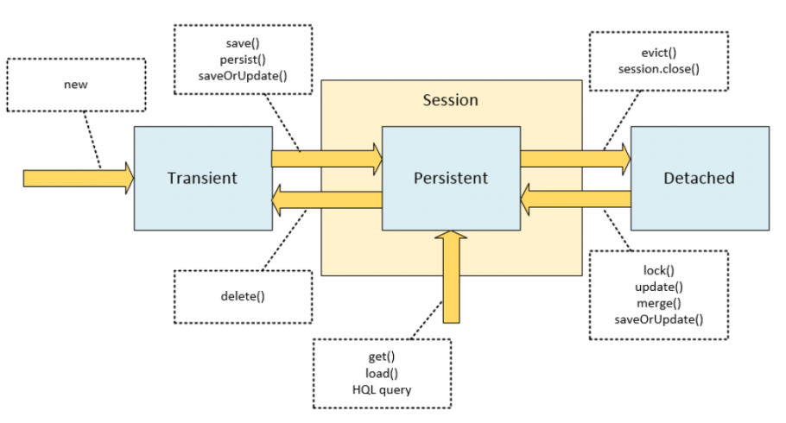
Hibetnate Object States/Lifecycle

Slide 6
Hibetnate Object States/Lifecycle
Transient:
The transient state is the initial state of an object.
Once we create an instance of POJO (Plain Old Java Object ) class, then the object entered in the transient state.
An object is not associated with the Session. So, the transient state is not related to any database.
The transient objects exist in the heap memory. They are independent of Hibernate.
Example:
// Here, object enters in the transient state.
Employee e=new Employee();
e.setId(101);
e.setFirstName("Gaurav");
e.setLastName("Chawla");

Slide 7
Hibetnate Object States/Lifecycle
Persistent:
As soon as the object associated with the Session, it entered in the persistent state.
The object is in the persistence state/persistence context when we save or persist it.
Each object represents the row of the database table.
So, modifications in the data make changes in the database.
Example:
session.save(e);
session.persist(e);
session.update(e);
session.saveOrUpdate(e);
session.lock(e);
session.merge(e);

Slide 8
Hibetnate Object States/Lifecycle
Detached:
Once we either close the session or clear its cache, then the object entered into the detached state.
As an object is no more associated with the Session, modifications in the data don't affect any changes in the database.
However, the detached object still has a representation in the database.
If we want to persist the changes made to a detached object, it is required to reattach the application to a valid Hibernate session.
To associate the detached object with the new hibernate session, use any of these methods - lock(), merge(), refresh(), update() or save() on a new session with the reference of the detached object.
Example:
session.close();
session.clear();
session.detach(e);
session.evict(e);

Slide 9
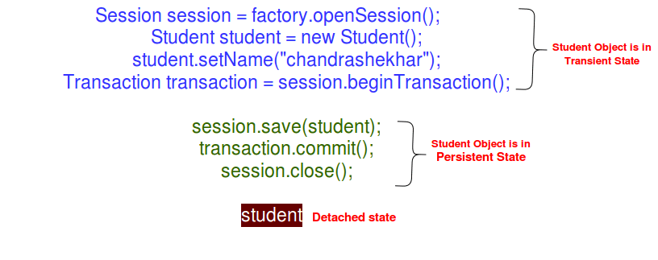
Hibetnate Object States/Lifecycle
Example:

Slide 10
persist() method
void persist(Object o): The persist method is intended for adding a new entity instance to the persistence context, i.e. transitioning an instance from transient to persistent state.
The person object has transitioned from transient to persistent state.
The object is in the persistence context now, but not yet saved to the database.
The generation of INSERT statements will occur only upon commiting the transaction, flushing or closing the session.
If an instance is detached, you should expect an exception, either upon calling this method, or upon committing or flushing the session.
Person person = new Person();
person.setName("John");
session.persist(person);
Notes:
- Được dùng để thêm một thực thể vào Persistence context ➔ câu lệnh INSERT chỉ được sinh ra khi khi transaction.commit() hoặc session.close().
Đối tượng truyền vào persist sẽ tham chiếu đến chính đối tượng sau khi được đổi trạng thái.
Nếu một đối tượng đang ở trạng thái persistent, khi truyền đối tượng ấy vào hàm persist() sẽ không gây thay đổi gì đến đối tượng đó
Nếu đối tượng đang ở trạng thái detached, thì sẽ có exception ném ra: hoặc bắn ra lúc gọi hàm persist(), hoặc ném ra lúc commit session.
Bản đặc tả không nói đến id của đối tượng sẽ được sinh ra ngay lúc gọi hàm persist() , dù cho ta chọn cách sinh ID như nào đi nữa. Bản đặc tả cũng cho phép các implementation của hàm persist() sinh ra câu lệnh SQL để generate ID cho đối tượng vào lúc commit hoặc flush session, và thế nghĩa là ID của đối tượng không hề được đảm bảo sẽ được sinh ra sau khi gọi hàm này, cho nên ta có thể gặp NULL nếu get cái ID ra sau khi gọi persist().

Slide 11
save() method
Serializable save(Object o): The save method is an “original” Hibernate method that does not conform to the JPA specification.
The call of save on a detached instance creates a new persistent instance and assigns it a new identifier, which results in a duplicate record in a database upon committing or flushing.
Person person = new Person();
person.setName("John");
Long id = (Long) session.save(person);
Notes:
Một số tài liệu nói: hibernate save() can be used to save entity to database. We can invoke this method outside a transaction, that’s why I don’t like this method to save data. If we use this without transaction and we have cascading between entities, then only the primary entity gets saved unless we flush the session.
➔ Đã thử nghiệm, chỉ thực hiện được outside với kiểu dữ liệu số và Identity.

Slide 12
merge() method
Object merge(Object o): The main intention of the merge method is to update a persistent entity instance with new field values from a detached entity instance.
if the entity is detached, it is copied upon an existing persistent entity;
if the entity is transient, it is copied upon a newly created persistent entity;
if the entity is persistent, then this method call does not have effect on it (but the cascading still takes place).
Person person = new Person();
person.setName("John");
session.save(person);
session.evict(person);
person.setName("Mary");
Person mergedPerson = (Person) session.merge(person);
Notes:
Nếu thực thể bị ở trạng thái detached, thực thể này sẽ được copy các giá trị bên trong nó để gán vào một thực thể trong Persistence Context
Nếu một thực thể ở trạng thái transient, nó sẽ được copy vào một đối tượng hoàn toàn mới trong Persistence Context
Việc áp dụng merge sẽ liên đới đến các relationship của đối tượng truyền vào hàm merge()
Nếu thực thể truyền vào merge() mà ở trạng thái persistent, hàm merge() sẽ không tác động đến thực thể này

Slide 13
update() method
void update(Object o): As with persist and save, the update method is an “original” Hibernate method that was present long before the merge method was added. Its semantics differs in several key points:
the update method transitions the passed object from detached to persistent
state;
this method throws an exception if you pass it a transient entity.
Person person = new Person();
person.setName("John");
session.save(person);
session.evict(person);
person.setName("Mary");
session.update(person);

Slide 14
saveOrUpdate() method
void saveOrUpdate(Object o): This method appears only in the Hibernate API and does not have its standardized counterpart. Similar to update, it also may be used for reattaching instances.
The main difference of saveOrUpdate method is that it does not throw exception when applied to a transient instance; instead, it makes this transient instance persistent.
Person person = new Person();
person.setName("John");
session.saveOrUpdate(person);

Slide 15
Conclusion
If you don't have any special requirements, as a rule of thumb, you should stick to the persist and merge methods, because they are standardized and guaranteed to conform to the JPA specification.
They are also portable in case you decide to switch to another persistence provider, but they may sometimes appear not so useful as the “original” Hibernate methods, save, update and saveOrUpdate.

Slide 16
Hibernate 5 Criteria Query Language
Section 02

Slide 17
Hibernate Criteria Query Language (HCQL)
Criteria queries offer a type-safe alternative to HQL, JPQL and native SQL queries (org.hibernate.Criteria API).
Criteria queries are a programmatic, type-safe way to express a query.
Criteria queries are essentially an object graph, where each part of the graph represents an increasing (as we navigate down this graph) more atomic part of the query.

Slide 18
Advantage of HCQL
The Criterion API (org.hibernate.Criteria) is one of the best parts of Hibernate.
The syntax is simple and very intuitive, so it is easy for the java programmer to add criteria.
It offers compile-time syntax checking, convenience of use.

Slide 19
Create Criteria in Hibernate 5
The basic steps to create a Criteria query are:
1 - Create a CriteriaBuilder instance by calling the Session.getCriteriaBuilder() method.
CriteriaBuilder builder = session.getCriteriaBuilder();
2 - Create a query object by creating an instance of the CriteriaQuery interface.
CriteriaQuery<T> query = builder.createQuery(T.class);
3 - Set the query Root by calling the from() method on the CriteriaQuery object to define a range variable in FROM clause.
Root<T> root = query.from(T.class);
4 - Specify what the type of the query result will be by calling the select() method of the CriteriaQuery object.
query.select(root);
5 - Prepare the query for execution by creating a org.hibernate.query.Query instance by calling the Session.createQuery() method, specifying the type of the query result.
Query<T> q = session.createQuery(query);
6 - Execute the query by calling the getResultList() or getSingleResult() method on the org.hibernate.query.Query object.
List<T> list = q.getResultList();

Slide 20
Create Criteria in Hibernate 5
Example 1: Selecting an entity
CriteriaBuilder builder = session.getCriteriaBuilder();
CriteriaQuery<Departments> criteria = builder
.createQuery(Departments.class);
Root<Departments> root = criteria.from(Departments.class);
criteria.select(root);
List<Departments> departments = session.createQuery(criteria)
.getResultList();

Slide 21
Create Criteria in Hibernate 5
Example 2: Selecting an expression
CriteriaBuilder builder = session.getCriteriaBuilder();
CriteriaQuery<Departments> criteria = builder
.createQuery(Departments.class);
Root<Departments> root = criteria.from(Departments.class);
criteria.multiselect(root.get("deptId"), root.get("deptName"));
List<Departments> departments = session.createQuery(criteria)
.getResultList();

Slide 22
Create Criteria in Hibernate 5
Example 3: Selecting multiple values
CriteriaBuilder builder = session.getCriteriaBuilder();
CriteriaQuery<Object[]> criteria = builder.
createQuery( Object[].class );
Root<Person> root = criteria.from( Person.class );
Path<Long> idPath = root.get("id");
Path<String> nickNamePath = root.get("nickName");
criteria.select( builder.array( idPath, nickNamePath ) );
criteria.where( builder.
equal(root.get("nickName"), "John Doe" ) );
List<Object[]> idAndNickNames = session.
createQuery( criteria ).getResultList();

Slide 23
Create Criteria in Hibernate 5
Example 3: Selecting multiple values
CriteriaBuilder builder = session.getCriteriaBuilder();
CriteriaQuery<Object[]> criteria = builder.
createQuery( Object[].class );
Root<Person> root = criteria.from( Person.class );
Path<Long> idPath = root.get("id");
Path<String> nickNamePath = root.get("nickName");
criteria.select( builder.array( idPath, nickNamePath ) );
criteria.where( builder.
equal(root.get("nickName"), "John Doe" ) );
List<Object[]> idAndNickNames = session.
createQuery( criteria ).getResultList();

Slide 24
Create Criteria in Hibernate 5
Using Expressions
The CriteriaBuilder can be used to restrict query results based on specific conditions.
By using CriteriaQuery where() method and provide Expressions created by CriteriaBuilder.
Common Examples:
To get items having a price more than 1000:
criteria.select(root).where(builder.gt(root.get("itemPrice"), 1000));
Getting items having itemPrice less than 1000:
criteria.select(root).where(builder.lt(root.get("itemPrice"), 1000));
Items having itemNames contain Chair:
criteria.select(root).where(builder.like(root.get("itemName"), "%chair%"));
Records having itemPrice in between 100 and 200:
criteria.select(root).where(builder.between(root.get("itemPrice"), 100, 200));

Slide 25
Create Criteria in Hibernate 5
Common Examples:
To check if the given property is null:
criteria.select(root).where(builder.isNull(root.get("itemDescription")));
To check if the given property is not null:
criteria.select(root).where(builder.isNotNull(root.get("itemDescription")));
Criteria API allows us to easily chain expressions:
Predicate greaterThanPrice = builder
.gt(root.get("itemPrice"), 1000);
Predicate chairItems = builder
.like(root.get("itemName"), "Chair%");
criteria.where(builder.and(greaterThanPrice, chairItems));

Slide 26
Create Criteria in Hibernate 5
Sorting
criteria.orderBy(
builder.asc(root.get("itemName")),
builder.desc(root.get("itemPrice")));

Slide 27
Create Criteria in Hibernate 5
GROUP BY and HAVING example
List<Departments> departments = session.createQuery(criteria)
.getResultList();
CriteriaBuilder builder = session.getCriteriaBuilder();
CriteriaQuery<Object[]> criteriaQuery =
builder.createQuery(Object[].class);
Root<Employee> root = criteriaQuery.from(Employee.class);
criteriaQuery.multiselect(builder.count(root.get("name")),
root.get("salary"), root.get("department"));
criteriaQuery.groupBy(root.get("salary"), root.get("department"));
criteriaQuery.having(builder.greaterThan(root.get("salary"), 30000));
Query<Object[]> query = session.createQuery(criteriaQuery);
List<Object[]> list = query.getResultList();

Slide 28
Create Criteria in Hibernate 5
FROM and JOIN example
session = HibernateUtils.getSessionFactory().openSession();
CriteriaBuilder builder = session.getCriteriaBuilder();
// Using FROM and JOIN
CriteriaQuery<Employees> criteriaQuery = builder
.createQuery(Employees.class);
Root<Employees> empRoot = criteriaQuery.from(Employees.class);
Root<Departments> deptRoot = criteriaQuery.from(Departments.class);
criteriaQuery.select(empRoot);
criteriaQuery.where(builder.equal(empRoot.get("department"),
deptRoot.get("deptId")));
Query<Employees> query = session.createQuery(criteriaQuery);
List<Employees> list = query.getResultList();
return list;
Notes:
Xem thêm về cách dùng Join khác:
https://docs.jboss.org/hibernate/orm/5.2/userguide/html_single/Hibernate_User_Guide.html#criteria-from-join
http://learningprogramming.net/java/hibernate5/join-in-criteria-query-in-hibernate-5/
https://www.boraji.com/hibernate-5-criteria-query-example
Ví dụ:
public List<Object[]> findAll() {
Session session = null;
try {
session = HibernateUtils.getSessionFactory().openSession();
CriteriaBuilder builder = session.getCriteriaBuilder();
CriteriaQuery<Object[]> criteria = builder
.createQuery(Object[].class);
Root<Departments> deptRoot = criteria.from(Departments.class);
Join<Departments, Employees> deptJoin = deptRoot.join("employees");
criteria.multiselect(deptRoot, deptJoin);
List<Object[]> departments = session.createQuery(criteria)
.getResultList();
return departments;
} finally {
if (session != null) {
session.close();
}
}
}

Slide 29
Create Criteria in Hibernate 5
HCQL Pagination
public List<UserInfor> search(int pageNumber, int pageSize) {
Session session = sessionFactory.getCurrentSession();
CriteriaBuilder criteriaBuilder = session.getCriteriaBuilder();
CriteriaQuery<UserInfor> criteriaQuery =
criteriaBuilder.createQuery(UserInfor.class);
Root<UserInfor> root = criteriaQuery.from(UserInfor.class);
criteriaQuery.select(root);
Query<UserInfor> query = session.createQuery(criteriaQuery);
query.setFirstResult((pageNumber - 1) * pageSize);
query.setMaxResults(pageSize);
List<UserInfor> listOfUser = query.getResultList();
sessionFactory.close();
return listOfUser;
}
Notes:
Session session = null;
try {
session = HibernateUtil.getSessionAndBeginTransaction();
CriteriaBuilder builder = session.getCriteriaBuilder();
CriteriaQuery<Trainee> criteriaQuery = builder.createQuery(Trainee.class);
Root<Trainee> root = criteriaQuery.from(Trainee.class);
criteriaQuery.select(root)
.where(builder.and(
builder.like(root.get("trnName"), "%" + traineeName + "%"),
builder.equal(root.get("trnEmail"), email),
builder.equal(root.get("birthDate"), birthDate)));
TypedQuery<Trainee> typedQuery = session.createQuery(criteriaQuery);
typedQuery.setFirstResult((pageNumber - 1) * pageSize);
typedQuery.setMaxResults(pageSize);
List<Trainee> trainees = typedQuery.getResultList();
return trainees;
} finally {
HibernateUtil.closeCurrentSessions(session);
}

Slide 30
Create Criteria in Hibernate 5
Aggregate functions examples
Count number of employees:
CriteriaQuery<Long> criteriaQuery = builder.createQuery(Long.class);
Root<Employees> root = criteriaQuery.from(Employees.class);
criteriaQuery.select(builder.count(root));
Query<Long> query = session.createQuery(criteriaQuery);
long count = query.getSingleResult();
System.out.println("Count = " + count);
Get max salary
CriteriaQuery<Integer> criteriaQuery = builder.createQuery(Integer.class);
Root<Employees> root = criteriaQuery.from(Employees.class);
criteriaQuery.select(builder.max(root.get("salary")));
Query<Integer> query = session.createQuery(criteriaQuery);
int maxSalary = query.getSingleResult();
System.out.println("Max Salary = " + maxSalary);

Slide 31
Create Criteria in Hibernate 5
Aggregate functions examples
Get Average Salary
CriteriaQuery<Double> criteriaQuery = builder.createQuery(Double.class);
Root<Employees> root = criteriaQuery.from(Employees.class);
criteriaQuery.select(builder.avg(root.get("salary")));
Query<Double> query = session.createQuery(criteriaQuery);
double avgSalary = query.getSingleResult();
System.out.println("Average Salary = " + avgSalary);
Count distinct employees
CriteriaQuery<Long> criteriaQuery = builder.createQuery(Long.class);
Root<Employees> root = criteriaQuery.from(Employees.class);
criteriaQuery.select(builder.countDistinct(root));
Query<Long> query = session.createQuery(criteriaQuery);
long distinct = query.getSingleResult();
System.out.println("Distinct count = " + distinct);

Slide 32
Hibernate 4 criteria query language (Chỉ cần Lựa chọn Hibernate 4 or 5)
Section: tham khảo thêm

Slide 33
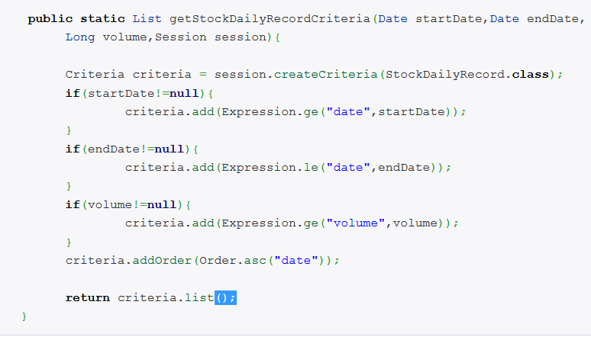
Criteria Queries Hibernate 4
Notes:
Java-based for API for building queries
Good for queries that are built up using lots of conditional logic; avoid messy string manipulation
This is Criteria example, you do not need to compare whether this is the first criteria to append the ‘where’ syntax, nor format the date. The line of code is reduce and everything is handled in a more elegant and object oriented way.

Slide 34
Restrictions class
The commonly used methods of Restrictions class are as follows:
public static SimpleExpression lt(String propertyName,Object value): sets the less than constraint to the given property.
public static SimpleExpression le(String propertyName,Object value): sets the less than or equal constraint to the given property.
public static SimpleExpression gt(String propertyName,Object value): sets the greater than constraint to the given property.
public static SimpleExpression ge(String propertyName,Object value): sets the greater than or equal than constraint to the given property.
public static SimpleExpression ne(String propertyName,Object value): sets the not equal constraint to the given property.
public static SimpleExpression eq(String propertyName,Object value): sets the equal constraint to the given property.
public static Criterion between(String propertyName, Object low, Object high): sets the between constraint.
public static SimpleExpression like(String propertyName, Object value): sets the like constraint to the given property.

Slide 35
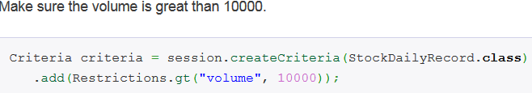
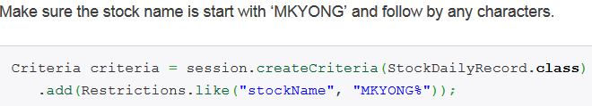
Restrictions class
Restrictions.eq, lt, le, gt, ge
(Criteria Queries : Equal (eq), Not Equal(ne), Less than (lt), Less than or equal(le), greater than (gt),greater than or equal(ge) and Ordering the results(Order.asc/desc))
Restrictions.like, between, isNull, isNotNull
(http://docs.jboss.org/hibernate/core/3.3/api/org/hibernate/criterion/Expression.html )

Slide 36
Criteria Query Samples
Criteria ordering query
criteria.addOrder(Order.asc("dateOfBirth"));
criteria.addOrder(Order.desc("salary"));
Criteria restrictions query
// HQL: tr.storeId=:storeId
criteria.add(Restrictions.eq("tr.storeId", storeId));
// HQL: tr.r.trafficTime>=:minDate
criteria.add(Restrictions.ge("tr.trafficTime", minDate));
// HQL: tr.r.trafficTime<:maxDate
criteria.add(Restrictions.lt("tr.trafficTime", maxDate));
criteria.add(Restrictions.between("dateOfBirth",
startDate, endDate));

Slide 37
Criteria Query Samples
Criteria restrictions query
criteria.add(Restrictions.like("name", "%th%"));
criteria.add(Restrictions.like("name", "%"+name+"%"));

Slide 38
Projections & Aggregations
Criteria cr = session.createCriteria(Employee.class);
// To get total row count.
cr.setProjection(Projections.rowCount());
// To get average of a property.
cr.setProjection(Projections.avg("salary"));
// To get distinct count of a property.
cr.setProjection(Projections.countDistinct("firstName"));
// To get maximum of a property.
cr.setProjection(Projections.max("salary"));
// To get minimum of a property.
cr.setProjection(Projections.min("salary"));
// To get sum of a property.
cr.setProjection(Projections.sum("salary"));

Slide 39
Create Criteria in Hibernate 4
public List<UserInfor> search(int pageNumber, int pageSize,
int searchType, int departmentId) {
Session session = sessionFactory.openSession();
Criteria criteria = session.createCriteria(UserInfor.class);
// Criteria with @JoinColumn (User (N) – (1) Department
Criteria depCrit = criteria.createCriteria("department");
if(departmentId > 0) {
depCrit.add(Restrictions.like("departmentId", departmentId ));
}
if (searchType == 1) {
criteria.add(Restrictions.like("isAdmin", 1));
}
if (searchType == 2) {
criteria.add(Restrictions.like("isEnable", 0));
}
if (searchType == 3) {
criteria.add(Restrictions.like("isEnable", 1));
}
criteria.setFirstResult((pageNumber - 1) * pageSize);
criteria.setMaxResults(pageSize);
List<UserInfor> listOfUser = criteria.list();
return listOfUser;
}

Slide 40
Summary
Hibetnate Object States/Lifecycle
Session methods: save(), persist(), saveOrUpdate(), update(), merge()
Hibernate 5 Criteria Query Language
Introduction
Basic steps to create a CriteriaQuery
Hibernate Criteria Examples
Notes:
Overview: What is hibernate & high level architecture

Slide 41

Thank you
41

